Slide 1

Department of Computer Science and Engineering
Authorship Identification through Text Mining
Review III
Date: 27 May 2021
Neelima Mukku : 17wh1a05a0
Sale Priyanka : 17wh1a0592
Shiramshetti Nandini: 18wh5a0516
Internal Guide: Mr.U ChandraSekhar
Designation : Associate Professor

Slide 2

Abstract
Why Should I Study this course?
The project aims to detect the identity of an anonymous author of a defamatory blog post or comment. A dataset samples containing list of authors is acquired, and then predict the anonymous author by using a custom machine learning model. The main task in this proposal is to build an authorship analysis model that will match a sample to the defamatory blogpost and reveal the anonymous author. Text preprocessing methods along with combination a of machine learning algorithms are employed .
The project consists of building a model that can learn authorship style and then scale the model to handle hundreds of such cases. Stylometry Analysis plays a major role in this project. An accuracy of 79% is obtained with 40 classes, which is improving with lesser number of classes.
Examples
BVRIT HYDERABAD College of Engineering for Women

Slide 3
Design
Data Extraction through XML parsing
Data preprocessing
Feature Extraction using NLP techniques
Building Authorship analysis model
Testing
Converting the Xml file posts into Data frame
Output
Examples

Slide 4
Accuracy and Performance metrics
S.No | Classes Size | Accuracy%
1 | 10 | 90
2 | 50 | 56
3 | 90 | 44
4 | 150 | 34
5 | 200 | 32
6 | 500 | 29
7 | 40(modified dataset) | 79

Slide 5
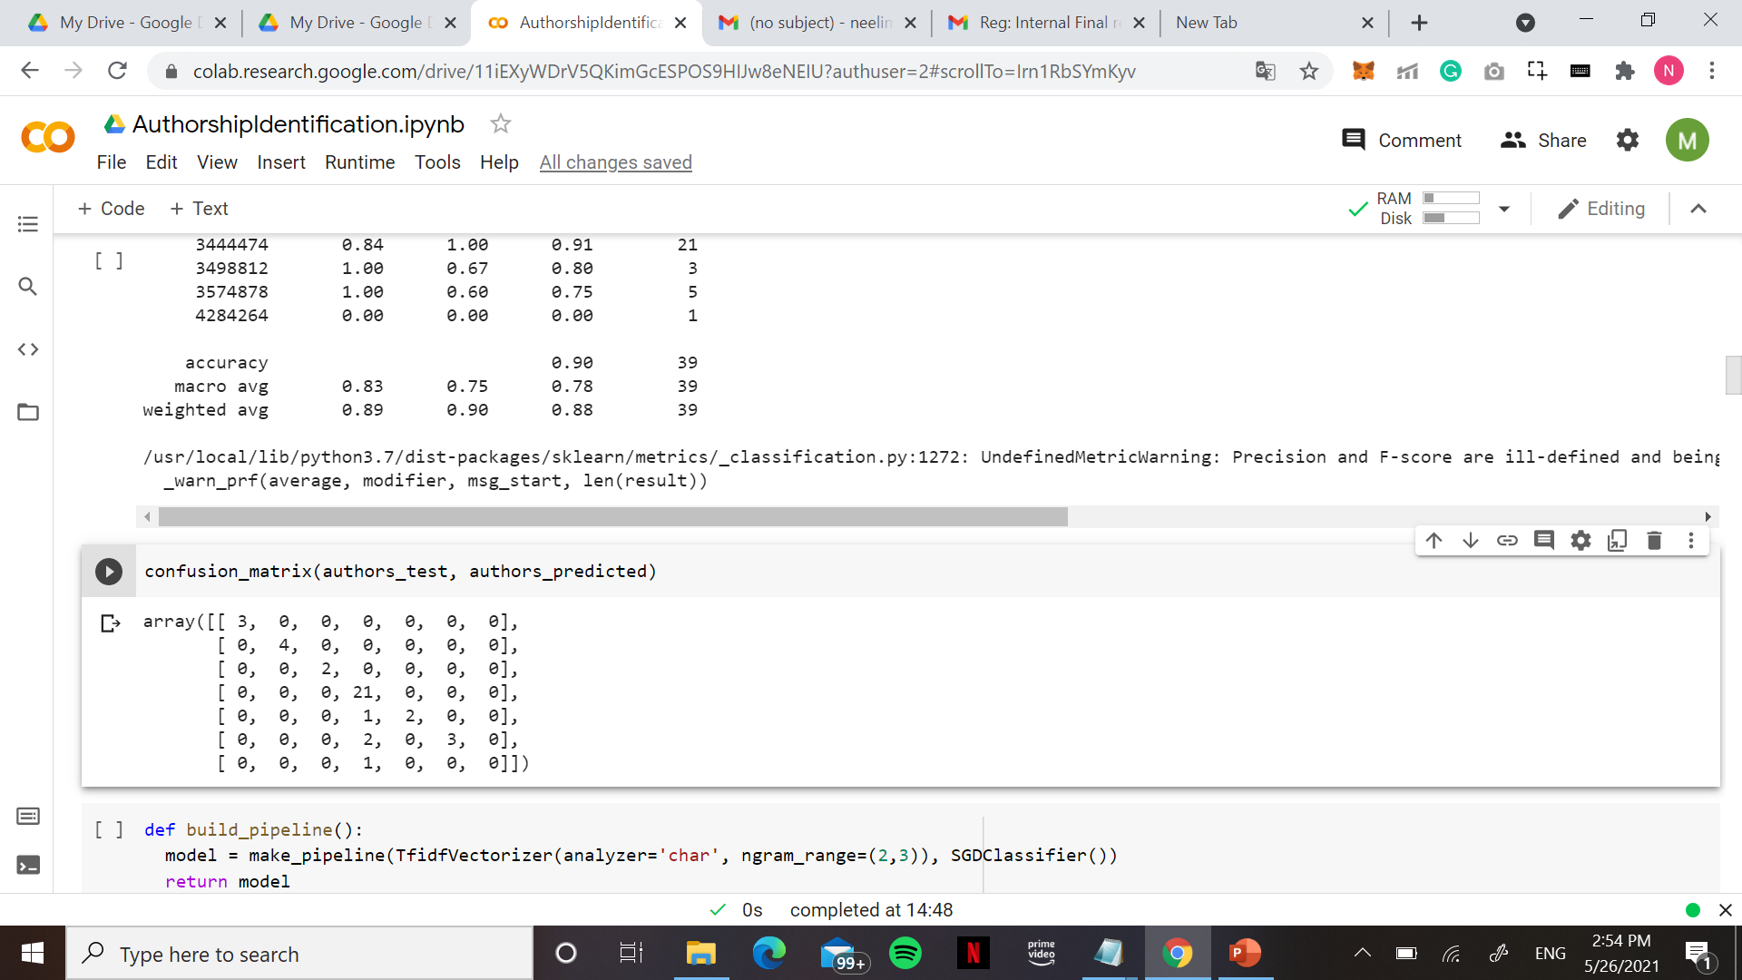
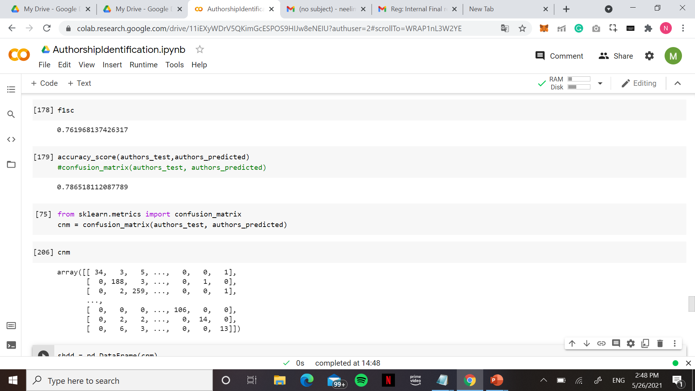
Accuracy and Performance metrics
Confusion Matrix for 10 authors
Confusion Matrix for Modified Dataset

Slide 6
Outputs
S.No | Real Author No | Predicted Author No
1 | 3585348 | 3585348
2 | 883178 | 883178
3 | 1596188 | 1596188
4 | 3522724 | 3523319
5 | 1662633 | 1662633
6 | 734562 | 589736

Slide 7
References
Why Should I Study this course?
Nacer Eddine Benzebouchi, Nabiha Azizi, Nacer Eddine Hammami, Didier Schwab, Mohammed Chiheb, Eddine Khelaifia, Monther Aldwairi Authors Writing Styles Based Authorship Identification System Using the Text Representation Vector in 2019 (Base paper)
Rıdvan Salih Kuzu, Koray Balci, Albert Ali Salah - Authorship recognition in a multiparty chat scenario in 2016(IEEE paper)
Rafael Guzmán-Cabrera, Manuel Montes-y-Gómez, Paolo Rosso, Luis Villaseñor-Pineda - A Web-Based Self-training Approach for Authorship Attribution by in 2017(springer)
Pramod Kumar Singh, Kanaparthy Sai Vivek, Shirisha Kodimala Stylometric analysis of E-mail content for author identification in 2017(ACM paper)
Hoshiladevi Ramnial, Shireen Panchoo, Sameerchand Pudaruth -Authorship Attribution Using Stylometry and Machine Learning Techniques in 2015 (springer)
Examples
BVRIT HYDERABAD College of Engineering for Women

Slide 8
Thankyou

